Slide 1
ZAS Academy
Python Curriculum for IOT & AI

Slide 2
Day2 - Agenda
Day 1 – Recap: Different ways to run python statements
Day 1 – Recap: Data Types, Control Statements
Given an array – find Min, Max, Sum, Average
Given an array – Sum & Average of all elements in even/odd Position
Given an Array – Search for a number
Given an Array – Sort
Write a program from IGCSE Computer Science Chapter 9 Problem Set
IGCSE – Paper 2 (Reading Home Work)

Slide 3
Recap – Day 1
Python Terminal/Command Prompt
Python Script File
Jupyter Notebook

Slide 4

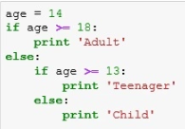
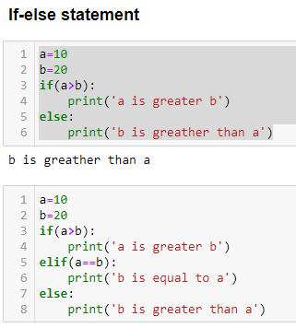
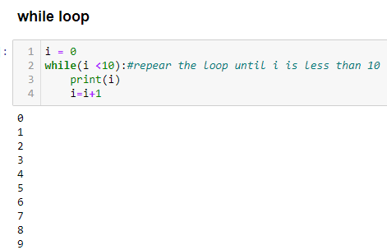
Recap – Day 1
Data Type
Int
Float
Double
String/Char
Lists
Arrays
Dictionary
Typle
Control Statements
If-else
If-elif
For
while
Data Types
Control Statements

Slide 5
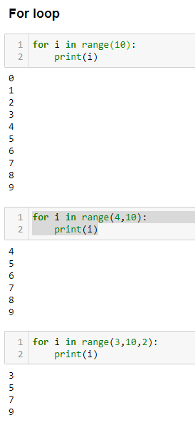
Recap – Day 1
Control Statements
If-else
If-elif
For
while

Slide 6
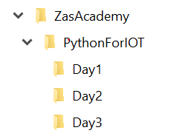
Python Directory Structure Setup
Create the following directory structure as working folder:

Slide 7
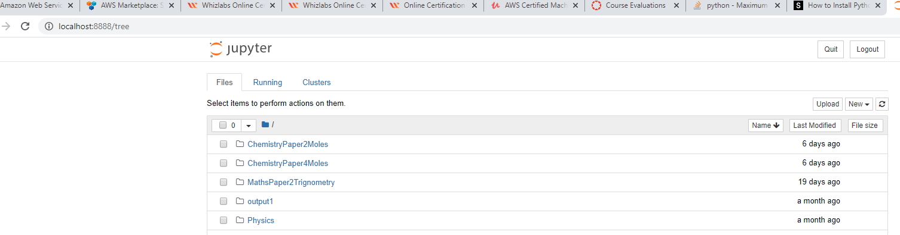
Run the Jupyter Notebook
From the command/terminal window run the following command to start the jupyter notebook
Jupyter notebook
If it runs successfully, you should see a browser windows similar to the screen print shown below.

Slide 8
Given an Array Find Total/Average
a=[4,6,0,6,2,1,-1,2]
i | a[i] | total
 |  | 0
0 | 4 | 4
1 | 6 | 10
2 | 0 | 0
3 | 6 | 16
4 | 2 | 18
5 | 1 | 19
6 | -1 | 18
7 | 2 | 20
Average | '20/8 | 2.5

Slide 9
Given an Array Find Min/Max Value
a=[4,6,0,6,2,1,-1,2]
i | a[i] | min_value (a[i]<min_value) | max_value (a[i] > max_value)
 |  | 999 | -999
0 | 4 | 4 | 4
1 | 6 | 4 | 6
2 | 0 | 0 | 6
3 | 6 | 0 | 6
4 | 2 | 0 | 6
5 | 1 | 0 | 6
6 | -1 | -1 | 6
7 | 2 | -1 | 6

Slide 10
Given an Array Find an Element
Target Value = 9
a=[4,6,0,6,2,1,-8,9,11]
i | a[i] | Found (a[i]==TargetValue)
 |  | FALSE
0 | 4 | FALSE
1 | 6 | FALSE
2 | 0 | FALSE
3 | 6 | FALSE
4 | 2 | FALSE
5 | 1 | FALSE
6 | -8 | FALSE
7 | 9 | TRUE
8 | 11

Slide 11
Sort a given Array
 |  |  |  |  | SWAP
a=[6,4,8,-1,3] |  |  |  |  |  | New | New
i | j | a[i] | a[j] | a[j]<a[i] | temp | a[j] | a[i]
0 | 1 | 6 | 4 | TRUE | 4 | 6 | 4
 | 2 | 4 | 8 | FALSE | 4 | 8 | 4
 | 3 | 4 | -1 | TRUE | -1 | 4 | -1
 | 4 | -1 | 3 | FALSE | -1 | 3 | -1
1 | 2 | 6 | 8 | FALSE | -1 | 8 | 6
 | 3 | 6 | 4 | TRUE | 4 | 6 | 4
 | 4 | 6 | 3 | TRUE | 3 | 4 | 3
2 | 3 | 8 | 6 | TRUE | 6 | 8 | 6
 | 4 | 6 | 4 | TRUE | 4 | 6 | 4
3 | 4 | 8 | 6 | TRUE | 6 | 8 | 6
4 | 5 | 8 |  |  |  |  | 8

